Slide 1
HTML Forms

Slide 2
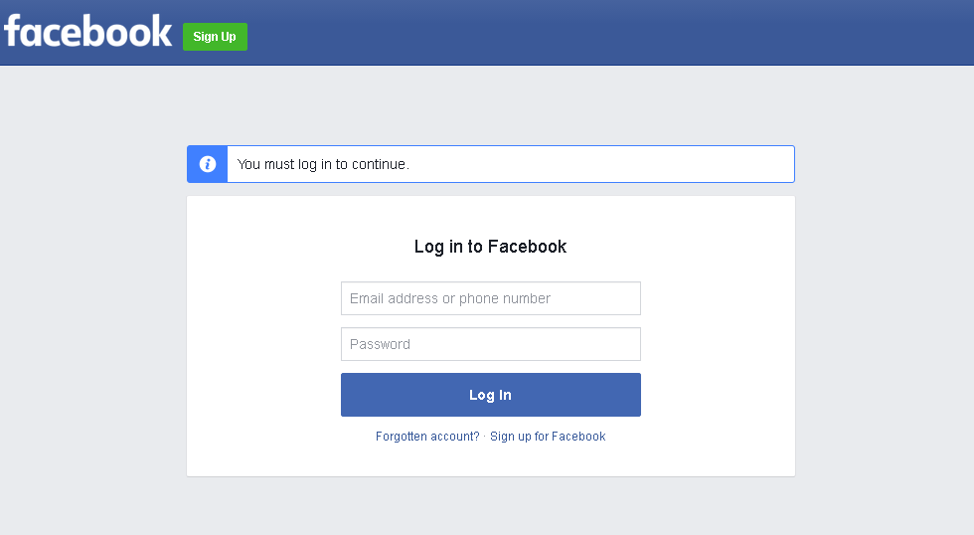
Forms

Slide 3
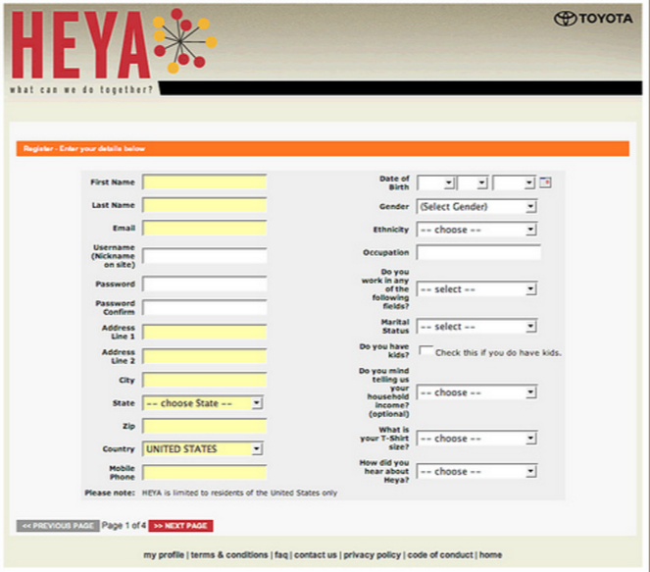
Forms

Slide 4
Forms
A form allows a user to enter data that can be used for any kind of processing.

Slide 5
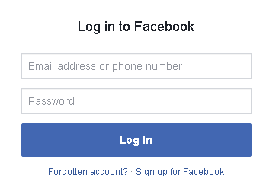

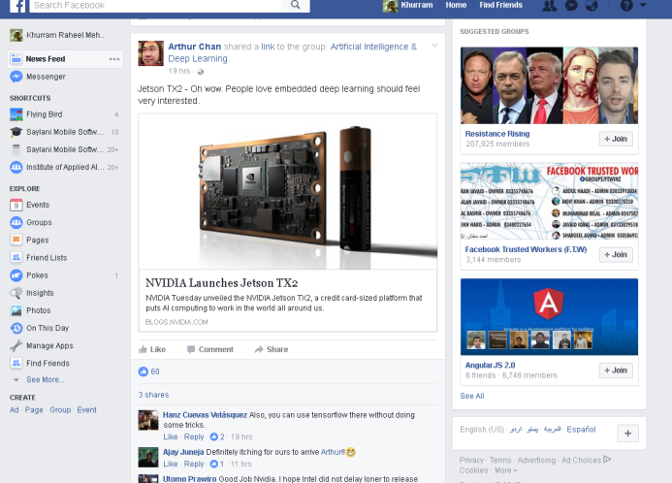
Forms
Facebook server

Slide 6
Creating Forms
Form should always be created with <form></form>

Slide 7







Components of Forms
text
Select
password
checkbox
radio
submit

Slide 8
Creating a simple form
<form action=“process.php”> <input id=“username” type=“text” /> <input id=“password” type=“password” /> <button type=“submit”>Submit</button> </form>

Slide 9
Create a text box
<input id=“username” type=“text” />

Slide 10

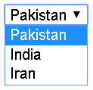
Create a select box
<select> <option>Pakistan</option>
<option>India</option>
<option>Iran</option>
</select>

Slide 11

Create radio buttons
<input type="radio" name="gender" value="Male" />
<input type="radio" name="gender" value="Female" />

